Slide 1
“QR-BASED CAMPUS EXIT MANAGEMENT SYSTEM”
Subtitle: “Improving Efficiency & Monitoring people in Educational Institutions”

Slide 2
TEAM MEMBERS
Batch Number-16
Submitted by :
N BHAGYASWARI (20NR1A0572)
R RAHUL (20NR1A0595)
N LALITHA LAYA DEVI (21NR5A0575)
D BHAGYA LAKSHMI (20NR1A05A7)
under the guidance of
Mr. S. Durga Prasad
‘Associate Prof’

Slide 3
ABSTRACT
The main purpose of the project is to define that, In any of the traditional college campus settings, managing student/faculty’s movements during the college hours poses significant challenges for administrators and security personnel. In the absence of a simplified exit management system often leads to inefficiencies, security breaches, and difficulties in monitoring the student/faculty’s presence.
The system aims to track the exit of individuals from the campus by requiring them to scan their unique QR codes upon leaving. This ensures that campus security can monitor departures effectively.

Slide 4
STRUCTURE ACROSS KEY–DOMAINS
QR Code Generation:- This involves the creation of Registrations & QR codes that will be used for campus exit verification for both students & Employees.
QR Scanner Mobile App using React Native:- We are developing a mobile application using React Native technology, allowing users to scan QR codes for efficient exit verification.
Admin Monitoring Student/Faculty’s presence through a Web Application:- This system incorporates dedicated scanners for both students and faculty members. Administrative oversight is facilitated through a watchman role, granting exclusive privileges for data modification, including updates, deletions, and modifications. Meanwhile, faculty and students are restricted to viewing and accessing data without the ability to alter it.
Analysis:- This domain encompasses the analysis of exit data collected through QR code scans, providing insights & reports for optimizing campus exit processes and security measures.

Slide 5
SOFTWARE REQUIREMENTS
Hardware Interfaces:
The system requires devices with camera functionality for QR code scanning, such as smartphones or tablets, to interact with the mobile application.
A server environment is necessary to host the web application and backend services, equipped with adequate processing power and storage capacity such as databases.
Software Interfaces:
Web Application:
The web application interface is accessible through standard web browsers such as Google Chrome, Mozilla Firefox, or Safari.
Mobile Application:
The mobile application interface is compatible with6 iOS and Android operating systems, accessible through smartphones or tablets.

Slide 6
Database:
The system interacts with the NoSql Database i.e; MongoDB database management system for storing and retrieving data in Json Format
User Interfaces:
Web Application Interface:
The web interface provides administrators with functionalities for user management, monitoring exits, generating reports through graphs, and managing system settings.
Mobile Application Interface:
The mobile interface allows watchmen or security personnel to scan QR codes, view exit records, and entry statuses in real-time.

Slide 7
EXISTING SYSTEM
The existing system for campus exit management typically relies on manual methods such as sign-out sheets or physical tokens like ID cards. These methods are prone to errors, time-consuming, and lack real-time monitoring capabilities.
Here are the key drawbacks of the existing system:
Manual Sign-out Sheets
Limited Tracking
More Dependency on Human Resources

Slide 8
PROPOSED SYSTEM
The proposed QR-Based Campus Exit Management System aims to address the limitations of the existing system by introducing an automated and efficient solution.
Here's how the proposed system improves upon the existing system:
QR Code Technology
Real-time Monitoring
Integration with Mobile App
Simple & Efficient
Enhanced Security
Accuracy

Slide 9
Advantages:
Real-time Monitoring:
Administrators can monitor exits in real-time through the web application,
viewing updated exit records and statistics.
Efficiency:
Streamlined tracking process saves time and reduces manual effort.
Transparency:
Administrators can easily access information.
Disadvantages:
Misleading of Data:
There are chances of misusing of student’s id-cards without their knowledge to
save the culprit’s credentials data.
Impact of Timings:
Incase of Missing of any scanning entry/exit points of an employee can effect their
timings as the system will not consider single entry/exit point.

Slide 10
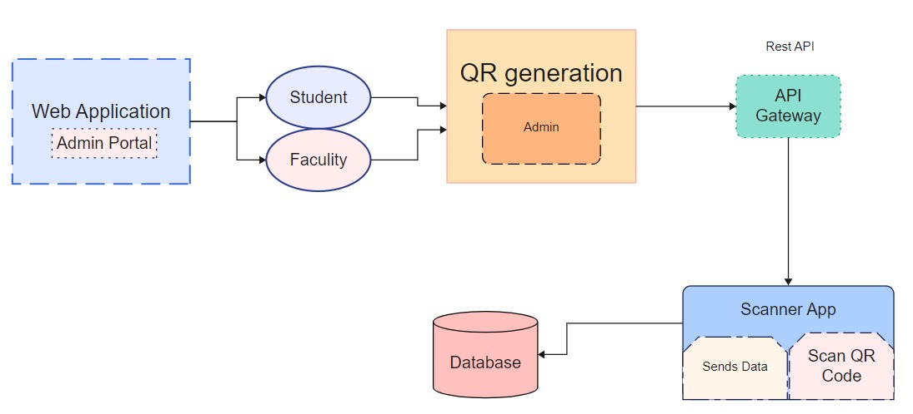
ARCHITECTURE
Monitor
This is the flow of the project

Slide 11
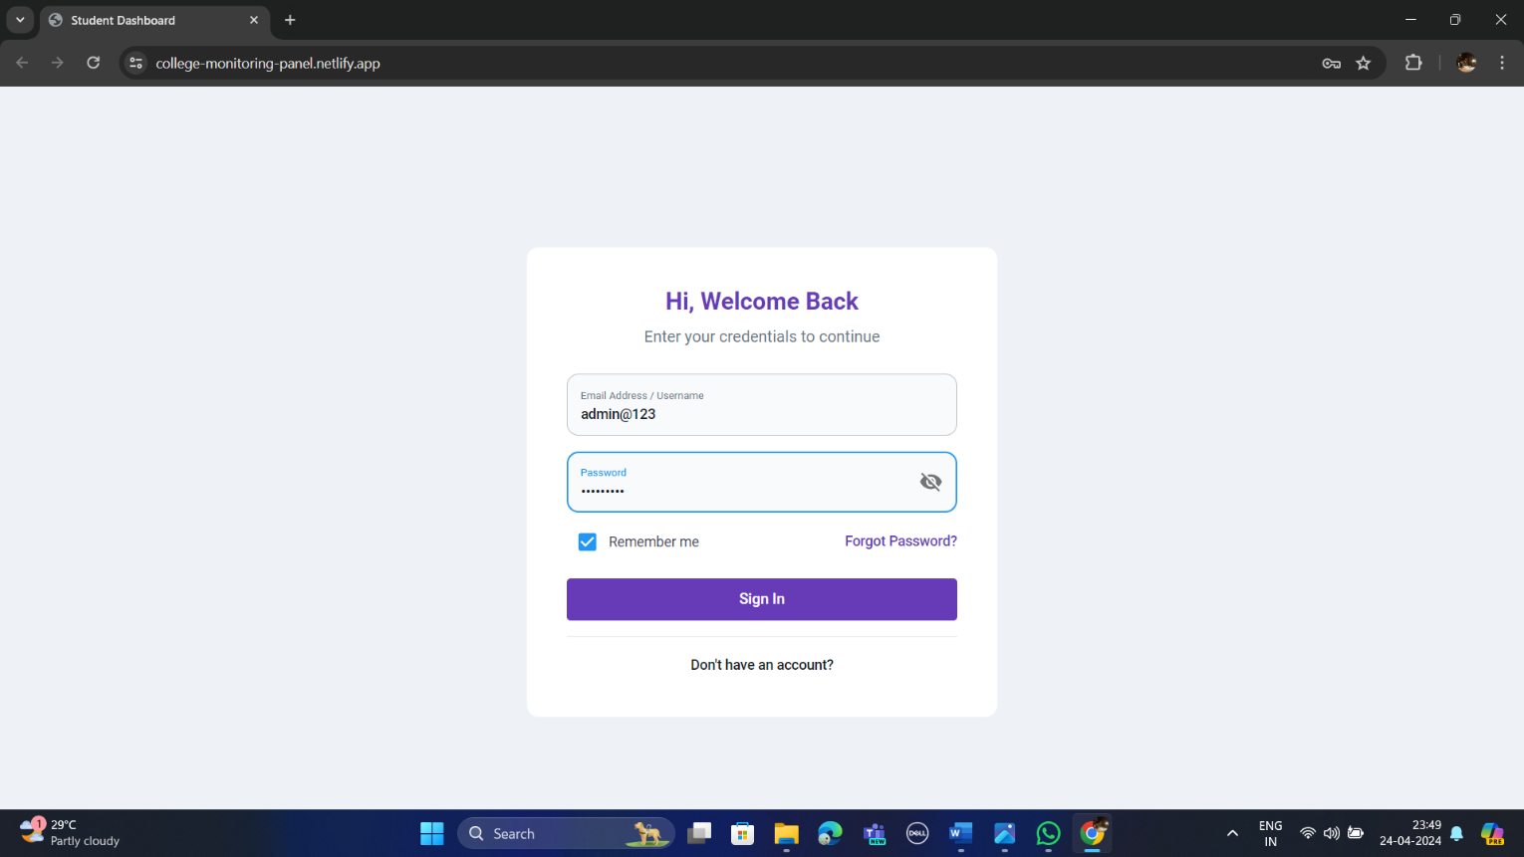
Snap Shots
Web-App
WEB - APP LOGIN PAGE

Slide 12
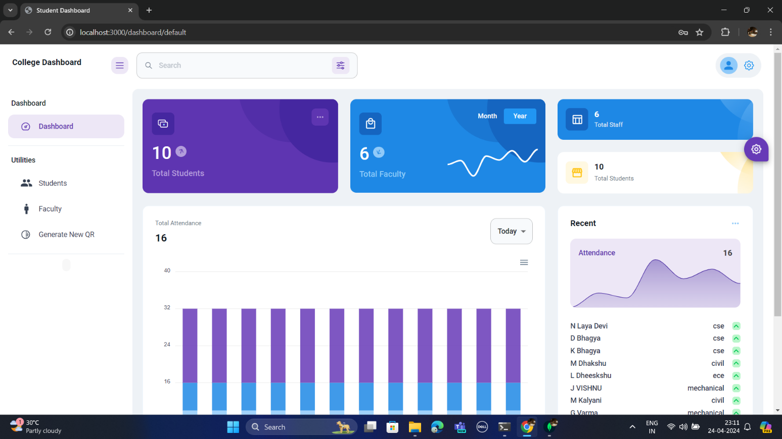
WEB – APP DASHBOARD

Slide 13
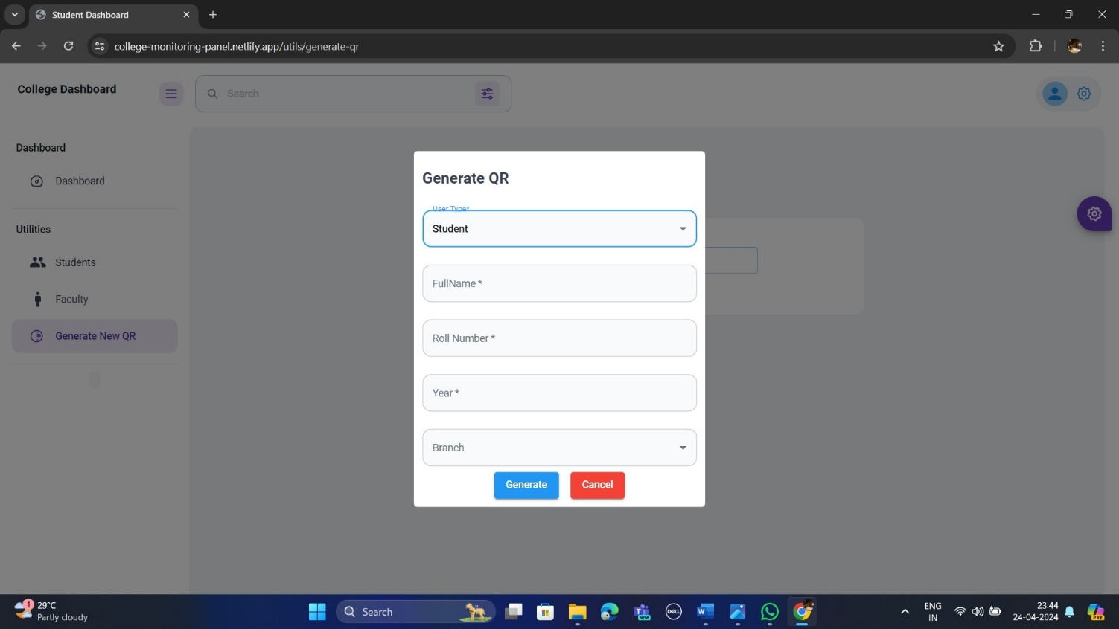
STUDENT QR-GENERATION

Slide 14
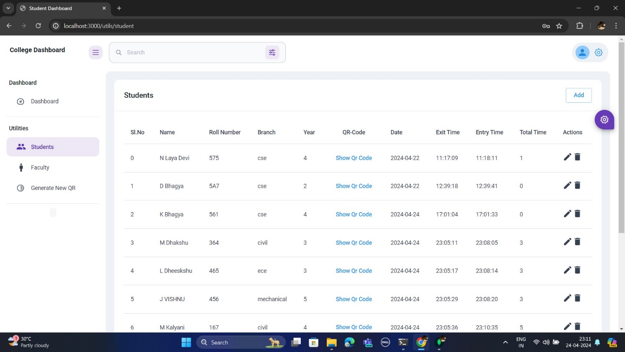
STUDENT TABLE DETAILS

Slide 15

FACULTY QR-GENERATION

Slide 16

FACULTY TABLE DETAILS

Slide 17
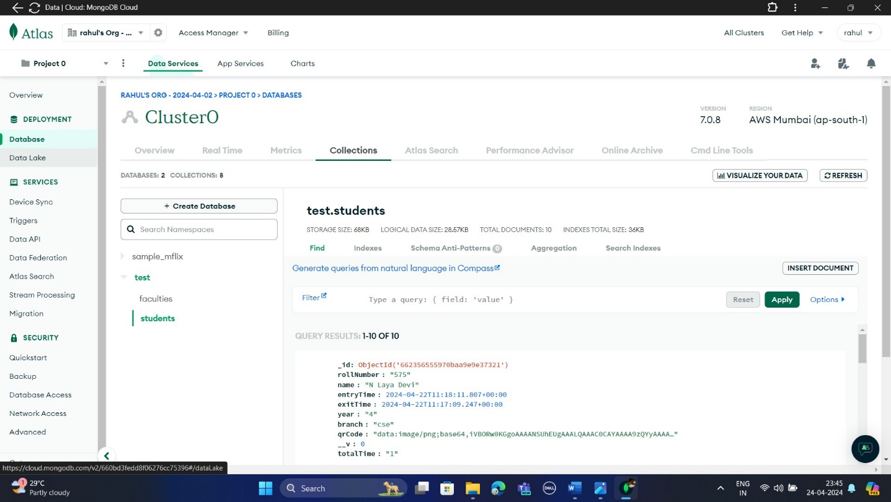
DATABASE – MongoDB (NoSql)
STUDENTS DATA COLLECTION

Slide 18
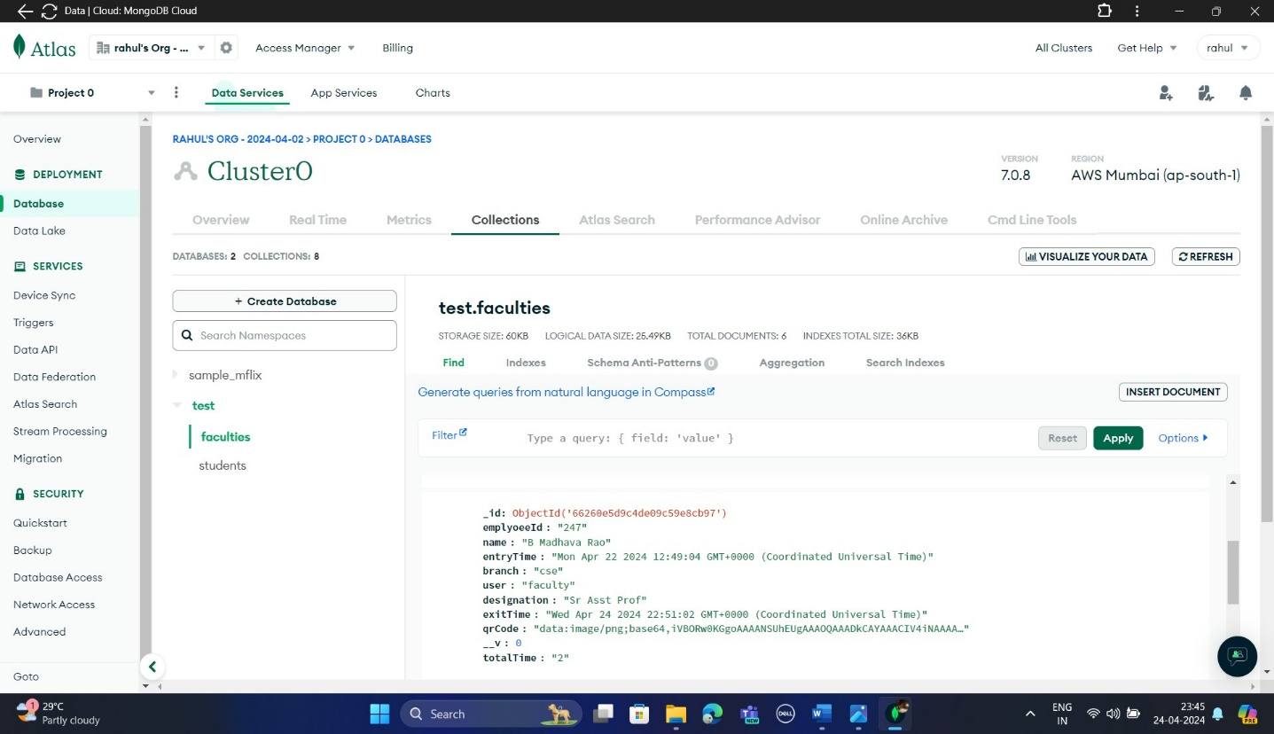
FACULTY DATA COLLECTION

Slide 19
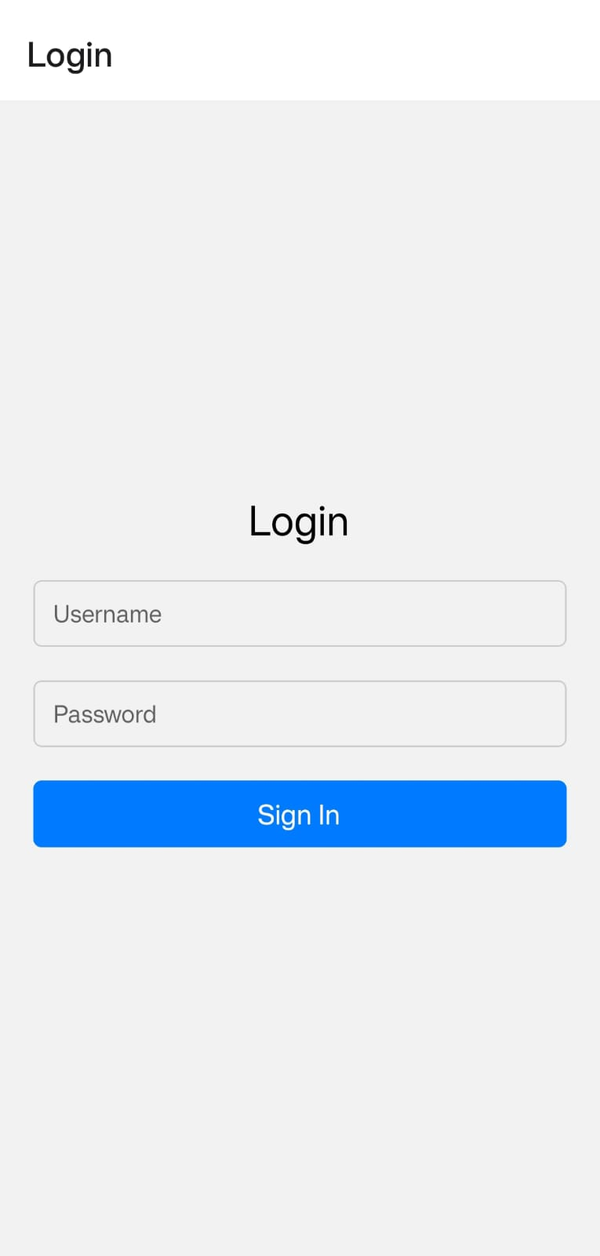
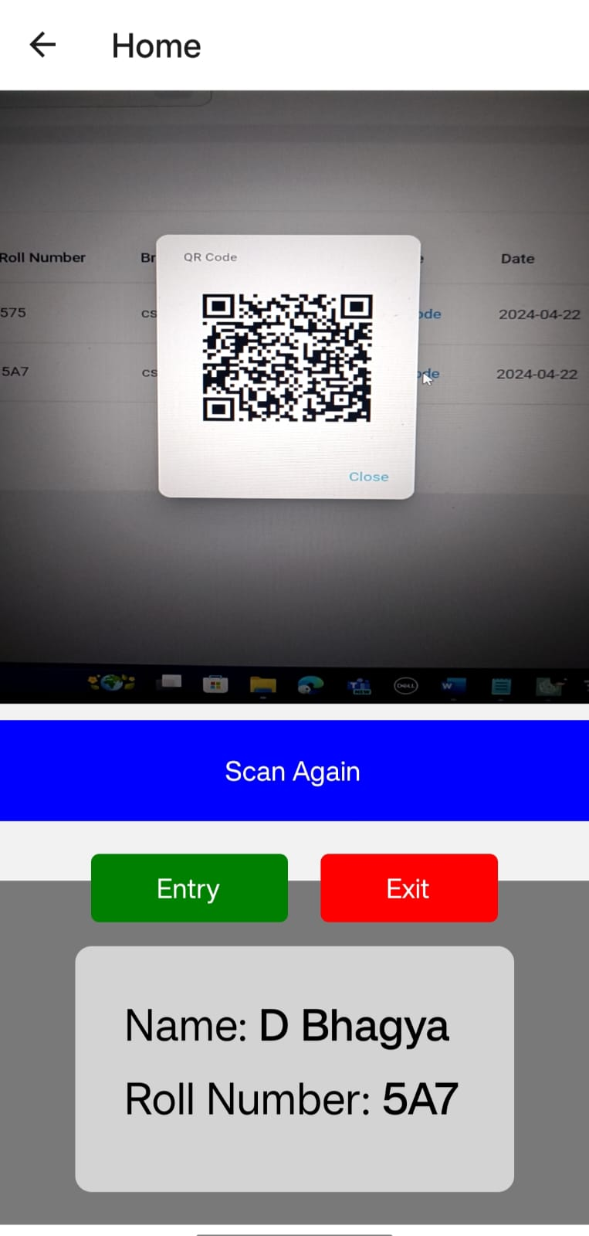
MOBILE APP
LOG-IN PAGE
APP INTERFACE

Slide 20
FUTURE ENHANCEMENTS
Push Notifications:
Introduce push notifications to notify administrators and users about important events, such as late exits, unauthorized entries, or system updates.
Offline Mode:
Develop an offline mode for the mobile app to allow security personnel to scan QR codes and update exit records even when internet connectivity is unavailable.
Integration with Student/Faculty Databases:
Integrate the system with normalization techniques, which needs less space to store & retrieve the data accurately.
Enhanced Reporting and Analytics:
Implement advanced reporting features to provide administrators with deeper insights into exit activities, peak hours, and user behaviour.

Slide 21


